Slide 1

ONLINE SURVEY ON “ZOOM EXHAUSTION AND FATIGUE” AMONG PRIVATE-SECTOR EMPLOYEES WORKING FROM HOME IN COLOMBO DISTRICT, SRI LANKA.
By Mary Shanmathi Uthayaraj
Faculty of Life & Health Sciences
Management and Science Institute

Slide 2
Contents
Chapter 1 – Introduction
Chapter 2 – Research Methodology
Chapter 3 – Results
Chapter 4 – Discussion
Chapter 5 – Conclusion and Recommendation

Slide 3
Chapter 1 : Introduction
Background of the study
Justification
Objectives of the Study
Limitations of the Study

Slide 4
Chapter 1: Introduction Background of the Study
In March 2020, the World Health Organization declared COVID-19 a pandemic. Video conferencing has become a crucial tool for education, healthcare, and business. The local index case emerged almost after 1½ months on 11 March 2020.
Sri Lanka's public sector also introduced WFH to ensure a smooth functioning of public services.
Lack of focus, motivation and productivity due to distractions in home working environment, conflicts in work and household responsibilities are the disadvantages of WFH arrangements.

Slide 5
Background of the Study
A standard questionnaire was used to assess participant weariness and exhaustion levels while working from home, mostly when participating in video conferences. Several questions on domains of zoom exhaustion and fatigue were included in the standard questionnaire (General, Visual, Social, Motivational, Emotional).
Zoom Fatigue is a feeling of exhaustion from participating in video conference calls. These include extraordinary amount of eye gaze at a close distance, limited physical mobility and constant viewing of self-video. Early research demonstrated that video conferencing increased cognitive load, compared to voice calls.

Slide 6
Justification
Today, corporate giants are shifting work culture from 'office based set up' to 'work from home' or 'remotely working' due to the volatility of the markets.
A thorough research should be conducted to analyze the critical issues, it's cause and possible solution. Laziness, ignorance and neglection are some of the frequently spoken issues within the corporates in Colombo.
This study will help to analyze if better awareness about work from home can improve the behavioral changes and fatigues in employees. The data shows that working from home is still not the ideal work environment for most employees.

Slide 7
Objectives of the Study
General Objective
To assess the zoom exhaustion and fatigue among the private sector employees who are working from home in Colombo District, Sri Lanka.

Slide 8
Objectives of the Study
Specific Objectives
To assess the level of zoom exhaustion and fatigue among the private sector employees working from home in Colombo District, Sri Lanka.
To determine the factors associated with zoom exhaustion and fatigue among private-sector employees working from home in Colombo District, Sri Lanka.

Slide 9
Limitations of the Study
The study is limited to a particular province in Sri Lanka where the survey does not represent the entire Western Province.
This cross-sectional survey method may not be able to bring to a conclusion or an association, because the association showed the p-value to be more than 0.05. This is due to the less sample size.
There has been a limited number of respondents for the questionnaire to be reached.

Slide 10
Chapter 2 : Research Methodology
Study Design - A descriptive cross-sectional online survey was conducted.
Study Setting - An online survey where the questionnaire will be shared through email and other social media platforms to be accessed by the private sector employees working from home in Colombo District, Sri Lanka.
Study Period - For a period of 10 months from October 2021 to June 2022.
Sampling Technique - To reach participants, convenience sampling was used.
Study Instruments - It was a self-administered, multiple choice and close-ended questionnaire. The questionnaire was developed by Google survey tool - Google Forms. survey. The questionnaire contained 34 questions.
The online questionnaire was divided into 6 parts: Introduction of the Study, Informed Consent, Socio-demographic factors, Working from home environment, Zoom exhaustion and fatigue scale and Submission of Form.

Slide 11
Chapter 2 : Research Methodology
Data Analysis - Descriptive statistical techniques like percentages were used to analyze qualitative data.
Frequency, percentage, mean, and standard deviation were used in the descriptive statistical analysis.
Correlation test analysis was used to find association between the dependent and independent.
A significant value (p-value) of less than or equal to 0.05 was considered as significant.
Ethical Issues And Clearance - The study was evaluated and approved in March 2022 by the Ethics Review Committee of the National Institute of Health Sciences (NIHS) – Kalutara, Sri Lanka.
Online informed consent was obtained from participants.

Slide 12
Chapter 3 : Results
Socio - demographic characteristics
Characteristics | Percentage (n)
Males | 44.0% (33)
Females | 56.0% (42)
Most of the participant’s were :
20-30 years of age (62.7%) (n=47)
Religion of Christianity (50.0%) (n=37)
Degree Holders (68.0%) (n=51)
Urban Residence (86.7%) (n=65)
Monthly Income above LKR 90,000 (37.3%) (n=28)

Slide 13
Chapter 3 : Results
Working from home environment of the employees
Parameter | Percentage of sample % (n)
How often do you work from home? Everyday Most days of the week Once or twice a week Depends on company requirements | 33.3 (25) 18.7 (14) 10.7 (8) 37.3 (28)
Is your working from home option, Full Time Part Time | 68 (51) 32 (24)
Do you have to work beyond your stipulated working hours? Yes No | 74.7 (56) 25.3 (19)
On average how long do you work online per day? 0 – 3hrs 4 – 6hrs 7 – 9hrs 10 – 12hrs | 1.3 (1) 14.7 (11) 58.7 (44) 25.3 (19)
Do you get distracted/disturbed while attending meetings due to family commitments? Yes No | 72 (54) 28 (21)
Do you face internet connectivity issues while attending meetings? Yes No | 88 (66) 12 (9)

Slide 14
Chapter 3 : Results
Zoom exhaustion and fatigue scale
Fifteen questions were asked under five main fatigue factors (General, Visual, Social, Motivational, Emotional). Each category contains three questions where “Not at all”, “Slightly”, “Moderately”, “Very” and “Extremely”.
General Fatigue Factors | Percentage of sample % (n)
How tired do you feel after video conferencing? Not at all Slightly Moderately Very Extremely | 9.3 (7) 28 (21) 41.3 (31) 20 (15) 1.3 (1)
How exhausted do you feel after video conferencing? Not at all Slightly Moderately Very Extremely | 14.7 (11) 24 (18) 33.3 (25) 24 (18) 4 (3)
How mentally drained do you feel after video conferencing? Not at all Slightly Moderately Very Extremely | 12 (9) 24 (18) 38.7 (29) 13.3 (10) 12 (9)
Visual Fatigue Factors | Percentage of sample % (n)
How blurred does your vision get after video conferencing? Not at all Slightly Moderately Very Extremely | 17.3 (13) 20 (15) 24 (18) 26.7 (20) 12 (9)
How irritated do your eyes feel after video conferencing? Not at all Slightly Moderately Very Extremely | 14.7 (11) 20 (15) 25.3 (19) 25.3 (19) 14.7 (11)
How much do your eyes hurt after video conferencing? Not at all Slightly Moderately Very Extremely | 12 (9) 21.3 (16) 21.3 (16) 32 (24) 13.3 (10)
Social Fatigue Factors | Percentage of sample % (n)
How much do you tend to avoid social situations after video conferencing? Not at all Slightly Moderately Very Extremely | 14.7 (11) 22.7 (17) 24 (18) 33.3 (25) 5.3 (4)
How much do you want to be alone after video conferencing? Not at all Slightly Moderately Very Extremely | 20 (15) 17.3 (13) 33.3 (25) 25.3 (19) 4 (3)
How much do you need time by yourself after video conferencing? Not at all Slightly Moderately Very Extremely | 10.7 (8) 20 (15) 30.7 (23) 32 (24) 6.7 (5)

Slide 15
Chapter 3 : Results
Zoom exhaustion and fatigue scale (continue…)
Motivational Fatigue Factors | Percentage of sample % (n)
How much do you dread having to do things after video conferencing? Not at all Slightly Moderately Very Extremely | 14.7 (11) 17.3 (13) 30.7 (23) 29.3 (22) 8 (6)
How often do you feel like doing nothing after video conferencing? Not at all Slightly Moderately Very Extremely | 17.3 (13) 18.7 (14) 17.3 (13) 36 (27) 10.7 (8)
How often do you feel too tired to do other things after video conferencing? Not at all Slightly Moderately Very Extremely | 13.3 (10) 25.3 (19) 20 (15) 29.3 (22) 12 (9)
Emotional Fatigue Factors | Percentage of sample % (n)
How emotionally drained do you feel after video conferencing? Not at all Slightly Moderately Very Extremely | 14.7 (11) 18.7 (14) 28 (21) 26.7 (20) 12 (9)
How irritable do you feel after video conferencing? Not at all Slightly Moderately Very Extremely | 13.3 (10) 17.3 (13) 22.7 (17) 38.7 (29) 8 (6)
How moody do you feel after video conferencing? Not at all Slightly Moderately Very Extremely | 9.3 (7) 25.3 (19) 29.3 (22) 32 (24) 4 (3)

Slide 16
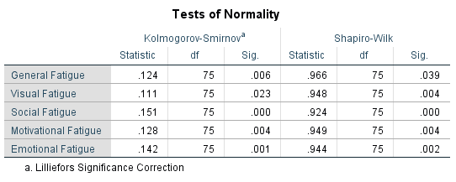
Chapter 3 : Results
Age and Monthly income variables among private-sector work from home employees in Colombo district.
Since the values are not falling between -1.96 to +1.96, the data distribution was taken as not normally distributed, hence chi-square test was used to analyze the associations.
Variable | Mean | Standard Deviation | Skewness | Kurtosis
Age | 29.21 | 6.418 | 0.971 | 0.709
Monthly Income | 2.73 | 1.223 | -0.562 | -0.679
Fatigue factor variables among private-sector work from home employees in Colombo district.
The normality test shows the significance values of all the fatigue factors and the significance values were less than 0.05. Therefore, the variables were normally distributed.

Slide 17
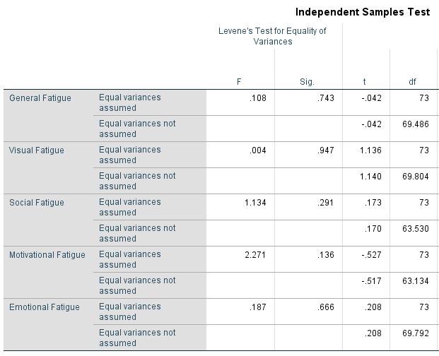
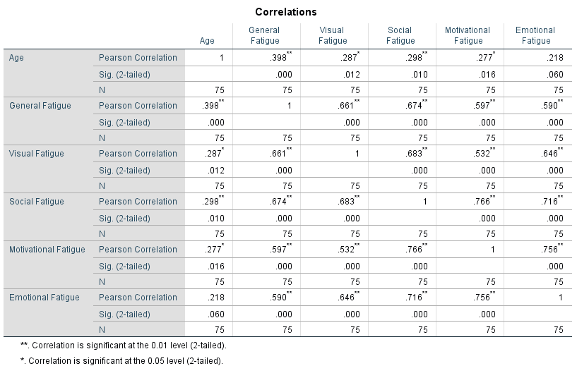
Chapter 3 : Results
Association between Fatigue factors and Socio-demographic factors
A significant value (p-value) of less than or equal to 0.05 was considered as significant.
To determine the association between fatigue factors and socio-demographic factors, correlation test was used.
Association between Gender and Fatigue factors among private-sector employees:
Relationship between Age and Fatigue factors among private-sector employees:

Slide 18
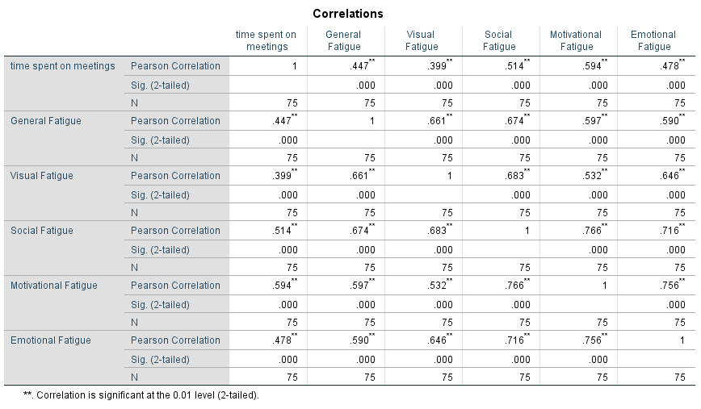
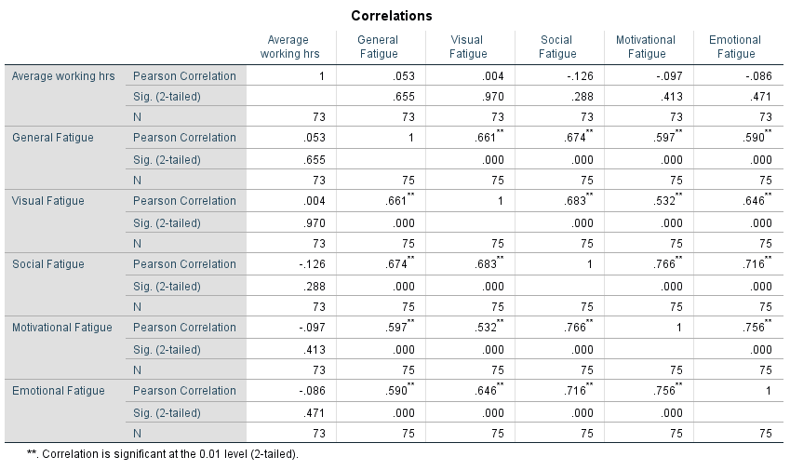
Chapter 3 : Results
Relationship between fatigue factors and WFH environment
A significant value (p-value) of less than or equal to 0.05 was considered as significant.
To determine the association between fatigue factors and WFH environment factors, correlation test was used.
Association between time spent on meetings and fatigue level among private-sector employees:
Association between average working hours and fatigue level among private-sector employees:

Slide 19
Chapter 4 : Discussion
Video conference platforms have been a crucial communication tool to maintain social connections and continuity of job profiles during the COVID-19 pandemic.
This is a key indicator which shows us that work and family commitments are interrupted due to work from home, especially during meetings, video conferences and working and attending meetings online beyond stipulated working hours.
The current research outlines the process and results of the development and validation of the online survey accessed through many social media platforms.
More importantly, for all questionnaires related to tiredness, fatigue, visual complications an average of 40 to 50% has either voted for ‘Very’ or ‘Extremely’ effected due to either video conferencing or zoom meetings. The online questionnaires have been validated by both video conference use and online meetings towards fatigue among employees in corporate sector.
Also, the study was conducted among private-sector employees work from home in selected area (Colombo district) only, if the study was conducted among WFH employees in all type of offices, and the data collected physically and covered a large area, a better result could have been obtained.

Slide 20
Chapter 5 : Conclusion and Recommendation
Both of these critical areas in life are being disturbed due to many factors, such as; long working hours, prioritizing family commitments during working hours, inadequate resources in competing the designated duties, lack of stable connectivity and etc.
In an ever-changing volatile market, it is vital to adopt new norm such as work from home and distance working habits. Important areas of concentration should be given to, no conflict of interest between work and family life balancing, strict adhering to working time or adopting flexible hours.
The challenges might seem tough to solve, and while it’s true that you’re likely always going to face some distraction and miscommunication, that doesn’t mean work from home needs to be difficult.
With the right mindset, attitude, a few useful tools, you can get your work from home change to operate as smoothly as they would from the office.

Slide 21
References
Rupietta, Kira; Beckmann, Michael. (2016). ‘Working from home: What is the effect on employees' effort?’, WWZ Working Paper, No. 2016/07, University of Basel, Center of Business and Economics (WWZ), Basel. Available at: http://dx.doi.org/10.5451/unibas-ep61317 [Accessed 6 July 2021].
Dana Rose Garfin, (2020), ‘Technology as a coping tool during the coronavirus disease 2019 (COVID-19) pandemic’, Available at: https://pubmed.ncbi.nlm.nih.gov/32762116/ [Accessed 6 July 2021].
Bick, A., Blandin, A., & Mertens, K. (2020). ‘Work from home after the COVID-19 outbreak.’ CEPR Discussion Paper No. DP15000, Available at SSRN: https://ssrn.com/abstract=3650114 [Accessed 8 July 2021].
Bloom, N., Davis, S. J., & Zhestkova, Y. (2021). ‘COVID-19 Shifted Patent Applications Toward Technologies that Support Working from Home.’ University of Chicago, Becker Friedman Institute for Economics Working Paper No. 2020-133. Available at: http://dx.doi.org/10.2139/ssrn.3695191 [Accessed 9 July 2021].
Bright, L. F., Kleiser, S. B., & Grau, S. L. (2015). Too much Facebook? An exploratory examination of social media fatigue. ‘Computers in Human Behavior’, 44, 148–155. Available at: https://doi.org/10.1016/j.chb.2014.11.048 [Accessed 9 July 2021].
Chawla, A. (2020). Coronavirus (COVID-19) – ‘Zoom’ application boon or bane. Available at SSRN: http://dx.doi.org/10.2139/ssrn.3606716 [Accessed 12 July 2021].
Comrey, A. L. (1988). Factor-analytic methods of scale development in personality and clinical psychology. American Psychological Association, 56, 754–61. Department of Health & Human Services. (2015). Symptoms of fatigue. Available at: https://www.betterhealth.vic.gov.au/health/conditionsandtreatments/fatigue [Accessed 16 July 2021].

Slide 22
References
Dol, K. S. (2016). Fatigue and pain related to internet usage among university students. Journal of Physical Therapy Science, 28(4), 1233–1237. Available at: https://doi.org/10.1589/jpts.28.1233 [Accessed 21 July 2021].
Feijt, M., De Kort, Y., Bongers, I., Bierbooms, J., Westerink, J., & Ijsselsteijn, W. (2020). Mental health care goes online: Practitioners’ experiences of providing mental health care during the COVID-19 pandemic. Cyberpsychology, Behavior, and Social Networking, 23(12), 860–864. Available at: https://doi.org/10.1089/cyber.2020.0370 [Accessed 22 July 2021].
Guadagnoli, E., Velicer W. F. (1988). Relation of sample size to the stability of component patterns. American Psychological Association, 103, 265–75. Hinds, P. J. (1999). The cognitive and interpersonal costs of video. Media Psychology, 1(4), 283–311. Available at: https://doi.org/10.1207/s1532785xmep0104_1 [Accessed 22 July 2021].
Iqbal, M. (2020). Zoom revenue and usage statistics. Business of apps. Available at: https://www.businessofapps.com/data/zoom-statistics/ [Accessed 22 July 2021].
Kline, P. A. (1993). Handbook of Psychological Testing. 2nd Ed. London: Routledge; Taylor & Francis Group. Lowenthal, P., Borup, J., West, R., & Archambault, L. (2020). Thinking beyond Zoom: Using asynchronous video to maintain connection and engagement during the COVID-19 pandemic. Journal of Technology and Teacher Education, 28(2), 383–391. Maslach, C. Burnout: The cost of caring. Englewood Cliffs, NJ: Prentice-Hall, 1982. Nanjundeswaran, C., Jacobson, B. H., Gartner-Schmidt, J., & Verdolini Abbott, K. (2015). Vocal Fatigue Index (VFI): Development and Validation. Journal of Voice, 29(4), 433–440. Available at: https://doi.org/10.1016/j.jvoice.2014.09.012 [Accessed on 25 July 2021].
Smets, E. M. A., Garssen, B., Bonke, B., de Haes, J. (1995). The multidimensional fatigue inventory (MFI) psychometric qualities of an instrument to assess fatigue. Journal of Psychosomatic Research, 39(5), 315–325. Available at: https://doi.org/10.1016/0022-3999(94)00125-O [Accessed on 26 July 2021].

Slide 23
Thank You

